Slide 1
RMI RPC

Slide 2
RPC model
Remote Procedure Call Parameter passing Semantics
Call process can be by following methods
1 call by reference
2 call by value
3 call by name
4 call by process
Special type of RPCCall Back
Broadcast
Batchmod

Slide 3
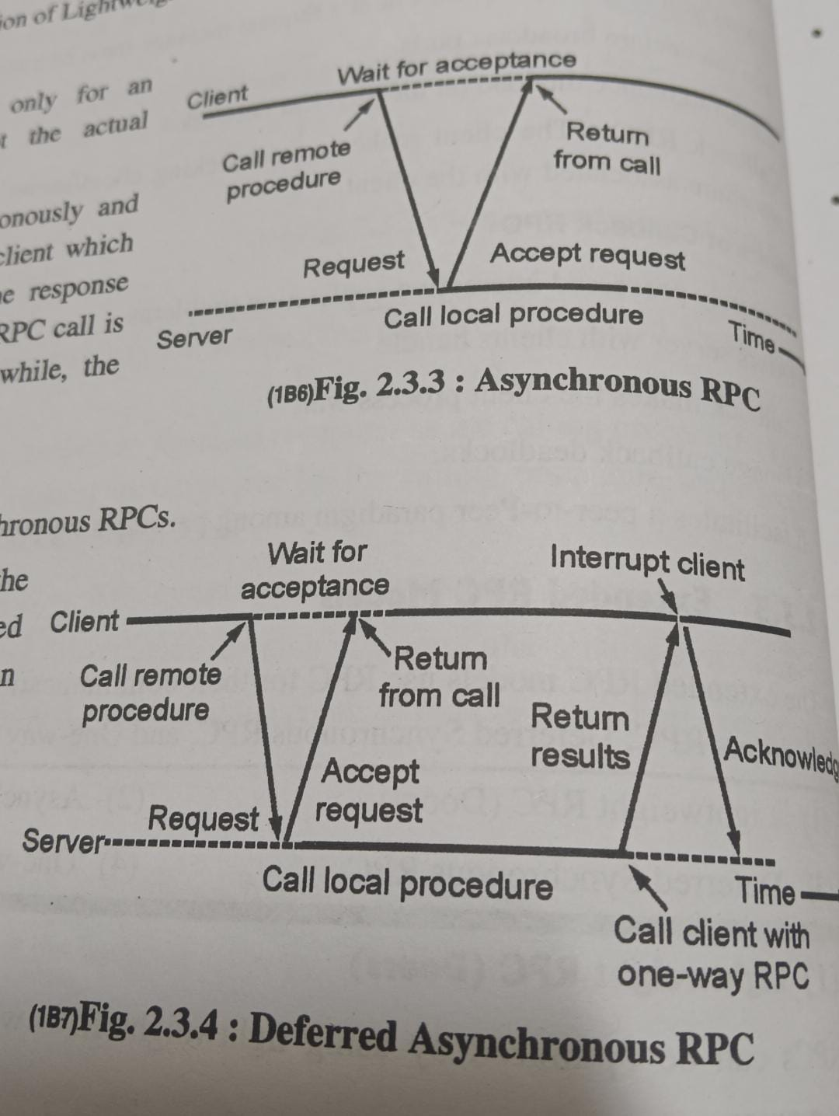

Slide 4
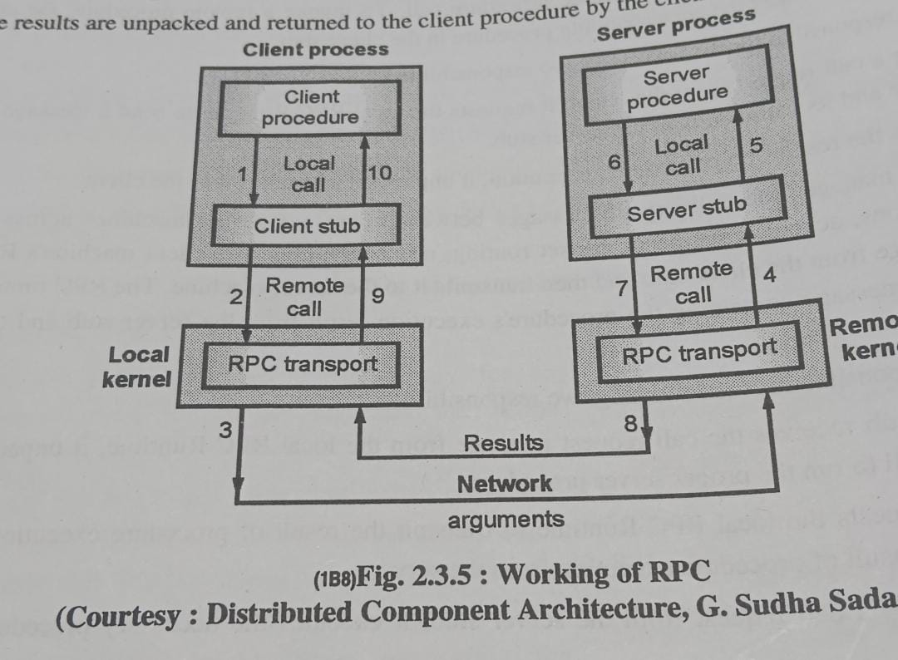

Slide 5
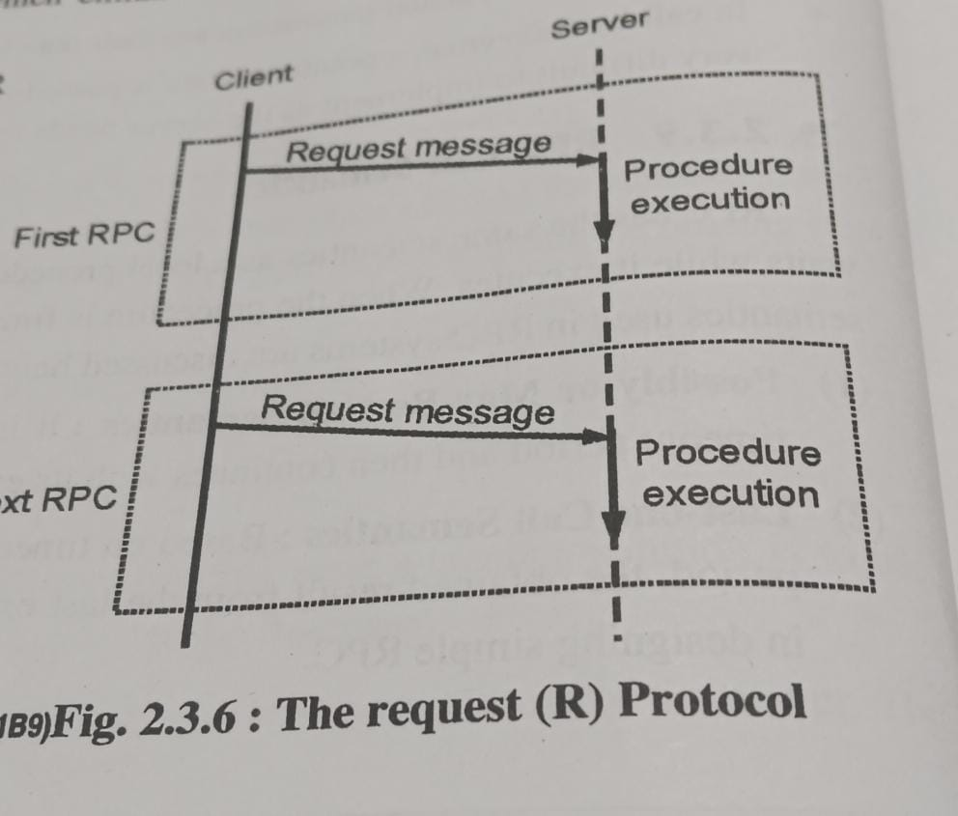

Slide 6
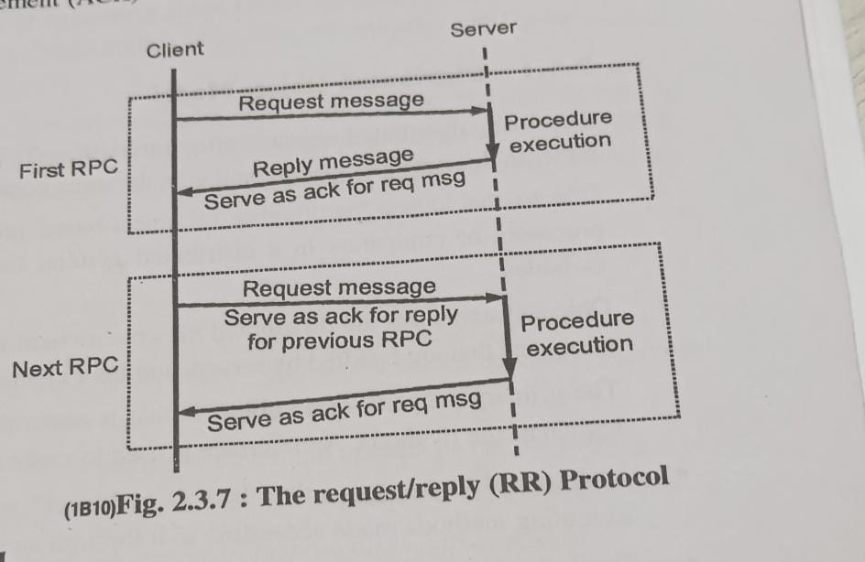

Slide 8
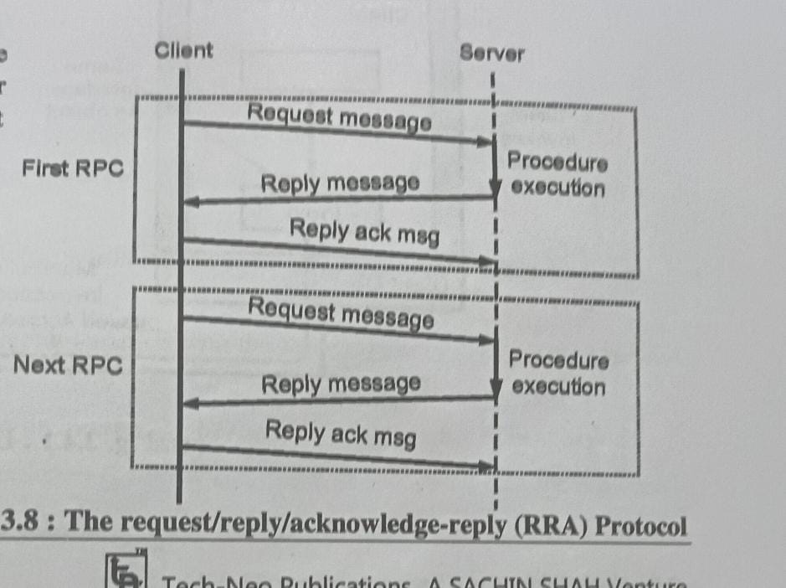

Slide 9
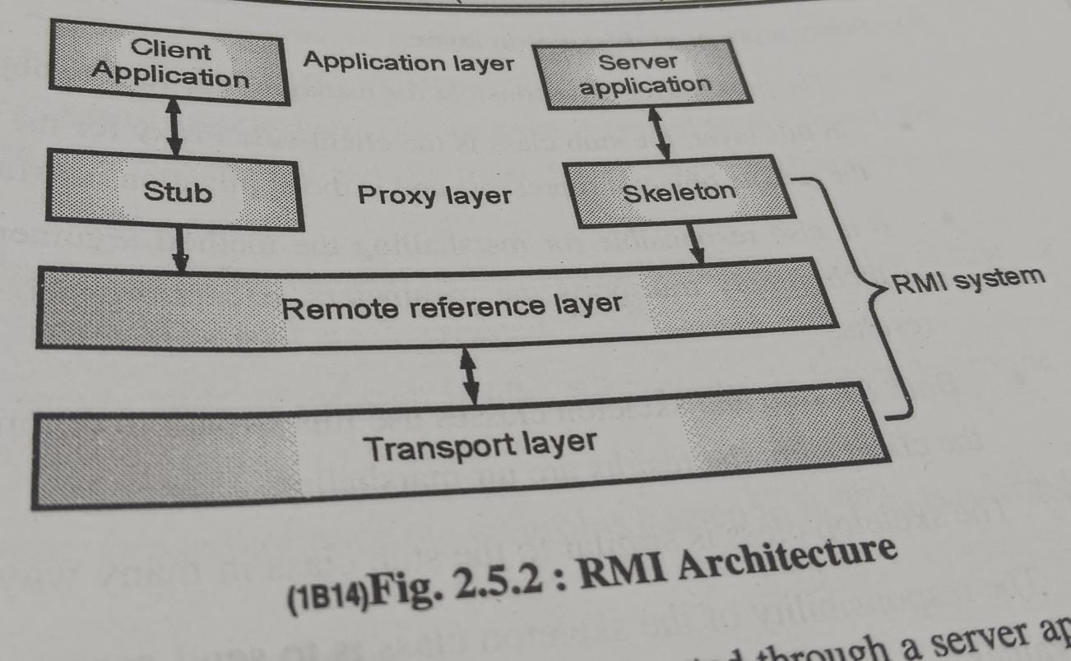
RMI

Slide 10
RMI

Slide 11
Server Management
Server Creation Semantics
Stateful Server
Stateless Server

Slide 12
Client Server Binding
Server Locating Mechanism
Multiple Simultaneous Binding
Binding Time

Slide 13
Complicated RPC
Rpc Involving long Delays
RPC involving too long arguments

